Slide 1

Travel Visa Inequality

Slide 2
MOTIVATION
The visa policies are changing rapidly with an intention to make the travel and exploration easier.
Even with rapid change, there is still inequality in travel policies.
So the objective of the project is to raise awareness for existing inequalities between different countries- one of the inequality.

Slide 3
OBJECTIVE
The main objective of this project to put forth a set interactive visualization where on can see the passport index across all the countries, different visa polices for a country compared to other countries, highlighting the advantages and disadvantages for each country
How the visa index and GDP per capita changed over the years.
How the visa index impacts the outgoing and incoming flow of people

Slide 4


DATA Source 1
code1 | code2 | visa_type1 | Visa type2
AFG | AFG | 5 | 5
AFG | AGO | 4 | 4
AFG | ALB | 4 | 4
AFG | ARE | 4 | 4
AFG | ARG | 4 | 4
AFG | ARM | 4 | 4
AFG | AUS | 3 | 4
AFG | AUT | 4 | 4
AFG | AZE | 4 | 4
AFG | BDI | 4 | 4
AFG | BEL | 4 | 4
AFG | BEN | 4 | 4
AFG | BFA | 4 | 4
AFG | BGD | 1 | 4
Data Description of Visa Type:
0: Visa Not required
1: Visa on Arrival
2: ETA Required
3. eVisa Required
4. Visa Required

Slide 5
DATA Source 2
Country Name | Code | Score | Year
Denmark | DNK | 130 | 2006
Finland | FIN | 130 | 2006
United States | USA | 130 | 2006
Germany | DEU | 129 | 2006
Sweden | SWE | 129 | 2006
Ireland | IRL | 129 | 2006
France | FRA | 128 | 2006
Italy | ITA | 128 | 2006
Japan | JPN | 128 | 2006
United Kingdom | GBR | 128 | 2006
Luxembourg | LUX | 125 | 2006
Switzerland | CHE | 127 | 2006
Norway | NOR | 127 | 2006
Belgium | BEL | 127 | 2006
Data is scraped using python requests library.
Score~ Henley Passport index
Year ~ 2006 -2019
https://www.henleypassportindex.com/passport

Slide 6
DATA Source 3
Country code | gdp_percapita | Incoming | Outgoing
CAN | 42752.66 | 16590000 | 32977000
ITA | 35685.6 | 47704000 | 29060000
CZE | 29017.84 | 9004000 | 5304000
ALB | 9930.94 | 2857000 | 3928000
CHL | 21942.15 | 3576000 | 2999000
SVN | 23295.34 | 2259000 | 2612000
CYP | 28224.46 | 2405000 | 1026000
BOL | 6131.06 | 798000 | 837000
KHM | 1006.84 | 2882000 | 710000
Data contains GDP per capita, incoming volume and outgoing volume.(~2018)
Kaggle.com

Slide 7
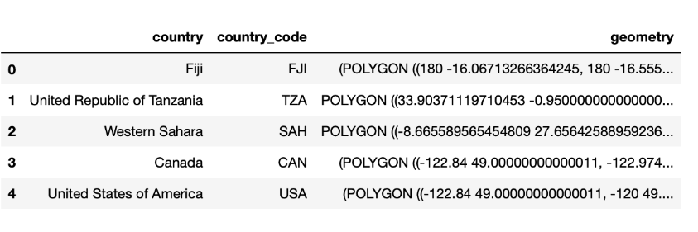
DATA Source 4
Shape file of countries
https://www.naturalearthdata.com/downloads/110m-cultural-vectors/

Slide 8
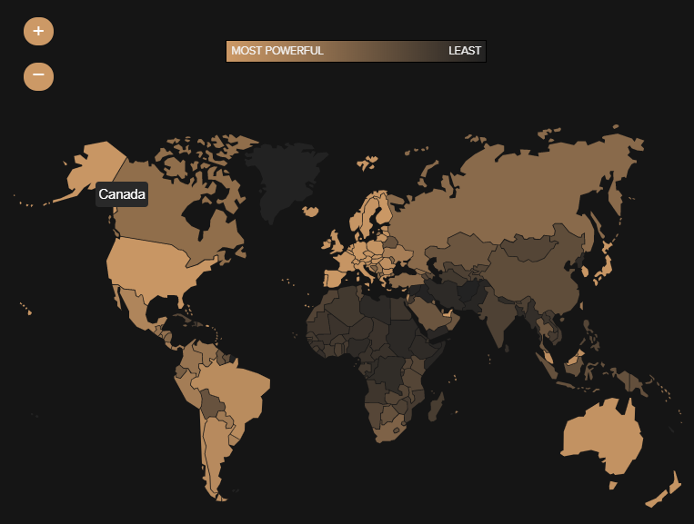
RELEVANT WORK

Slide 9
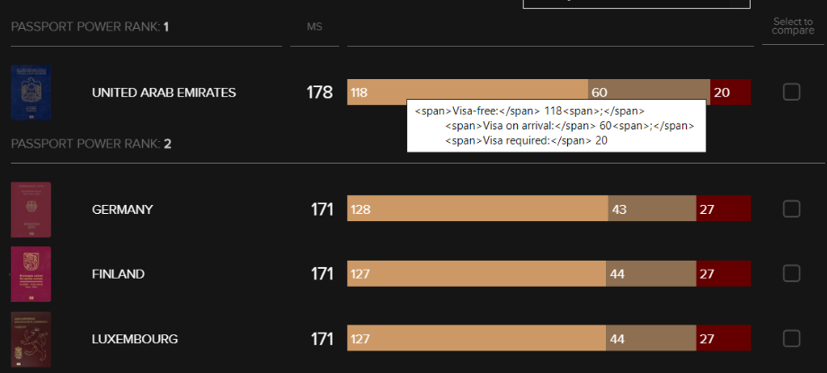
RELEVANT WORK

Slide 10
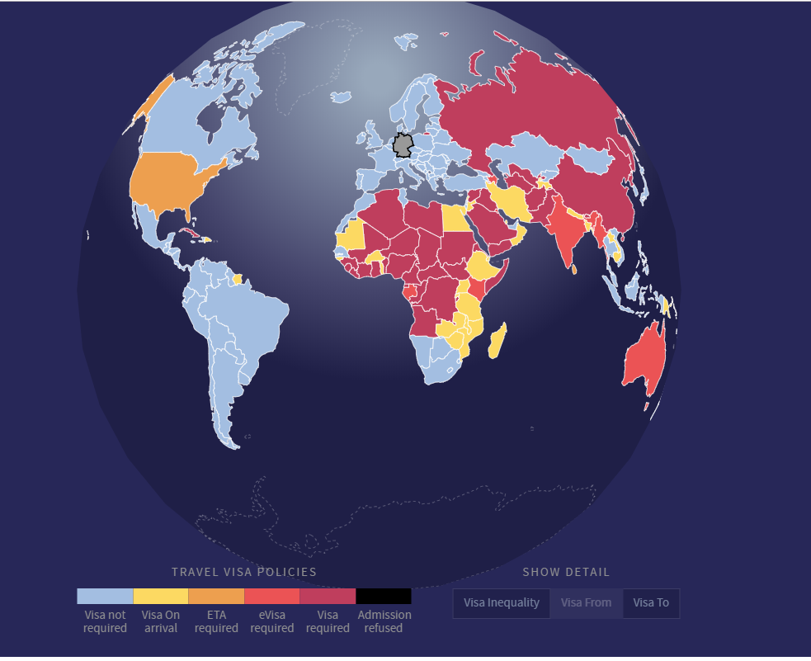
RELEVANT WORK

Slide 11
VISUALIZATION
Scatter plot
Bar Plot
Line Plot
Map Visualization

